Slide 1


NSE Sector Rotation Allocation Engine
A quantitative tactical allocation framework tracking cross-sectional momentum and historical macroeconomic catalysts across the Indian equity markets.

Slide 2


The Strategic Rotation Gap
The Retail Problem
The Quantitative Engine
Most retail investors lose performance edge by over-analyzing single stock micro-fundamentals while remaining completely blind to massive, structural institutional sector-level capital flows.
This project resolves macro blindspots by tracking cross-sectional market momentum. It translates raw pricing, velocity, and volume data into a clear tactical asset allocation playbook.
Without a systematic macro tracker, investors consistently buy at the peak of distribution cycles and exit during critical accumulation phases.
By treating sector shifts as structural cycles, the framework actively captures the ocean currents of institutional liquidity on the NSE India.

Slide 3
Quant Engine Mechanics
Cross-Sectional Momentum Rating Calculates short-to-medium term structural velocity based on relative strength metrics rather than isolated price movements.
Velocity & Volume Convergence Tracks institutional footprints by ensuring price acceleration is systematically backed by above-average transaction volumes.
Catalyst Overlay Modeling Overlays major macroeconomic announcements (e.g., Union Budgets, RBI decisions) on forward return performance profiles.
Automated Compositing Schema Multi-factor weighting logic compiled cleanly in dynamic DAX calculations for scalable dashboard visualization.

Slide 4
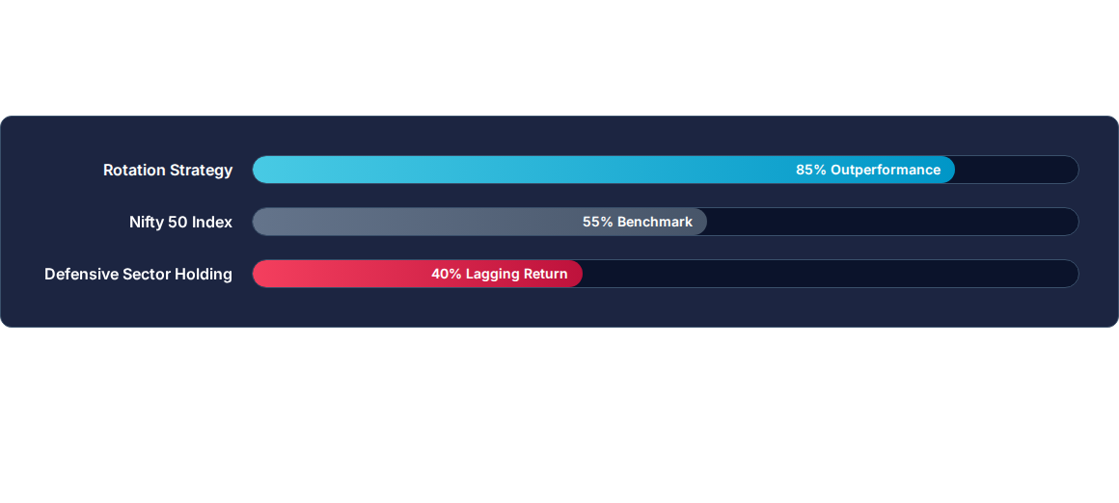
Simulated Performance Edge
Simulation demonstrates that systematic tactical allocation utilizing active sector rankings captures structural waves, generating clear alpha over static market index holdings.

Slide 5
System Execution Phases
02 - ETL Schema
04 - UX Layouts
Designed a robust star schema in Power Query, handling long-format macro factors and wide-format market variables.
Constructed dashboard interfaces optimizing information density—minimizing scroll fatigue while highlighting tactical plays.
01 - Data Ingestion
03 - DAX Architecture
Wrote scraping pipelines to gather clean historic pricing, index weightings, and transaction volume data from NSE India.
Engineered multi-layered calculation tables to capture daily structural decay, relative ranks, and event timelines.

Slide 6

System Schema Architecture
Data Asset / Table Name | Schema Format | Primary Relational Key | Strategic Business Function
nse_sector_composite_scores | Wide Flat Table | `Date` + `Sector_ID` | Computes daily cross-sectional ranking indices and momentum heights.
nse_macro_rotation_overlay | Long Event Table | `Catalyst_Date` | Houses historical calendar occurrences (RBI rate adjustments, budget drops).
nse_sector_data | Timeseries Wide | `Date` | Stores raw historical index close metrics to support backtesting validation.
nse_sector_signals | Normalized Keyed | `Sector_ID` | Maps individual asset classification groups and industry groupings.

Slide 7
Explore the Model Architecture
The entire quantitative engine is completely open-source and structured for localized replication. You can clone the project directly, inspect the dynamic DAX measures, audit the schema relations, and adapt the underlying ETL queries for your own financial pipelines.
Run the Engine Locally on GitHub

